Slide 1
CS162 Operating Systems and Systems Programming Lecture 18 File Systems
April 2nd, 2018
Profs. Anthony D. Joseph & Jonathan Ragan-Kelley
http://cs162.eecs.Berkeley.edu
Notes:
Today we're going to talk about File Systems

Slide 2
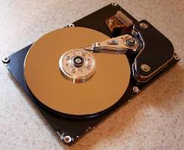
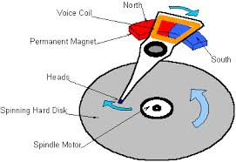
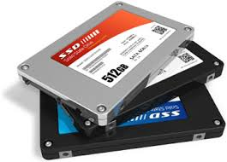

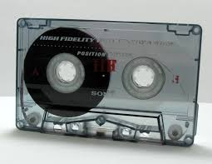
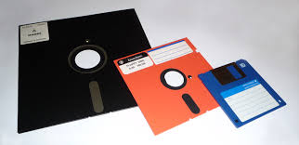
I/O & Storage Layers
Operations, Entities and Interface
Application / Service
streams
High Level I/O
Low Level I/O
handles
Syscall
registers
file_open, file_read, … on struct file * & void *
File System
descriptors
we are here …
I/O Driver
Commands and Data Transfers
Disks, Flash, Controllers, DMA

Slide 3
Recall: C Low level I/O
Operations on File Descriptors – as OS object representing the state of a file
User has a “handle” on the descriptor
#include <fcntl.h>
#include <unistd.h>
#include <sys/types.h>
int open (const char *filename, int flags [, mode_t mode])
int create (const char *filename, mode_t mode)
int close (int filedes)
Bit vector of:
Access modes (Rd, Wr, …)
Open Flags (Create, …)
Operating modes (Appends, …)
Bit vector of Permission Bits:
User|Group|Other X R|W|X
http://www.gnu.org/software/libc/manual/html_node/Opening-and-Closing-Files.html

Slide 4
Recall: C Low Level Operations
ssize_t read (int filedes, void *buffer, size_t maxsize)
- returns bytes read, 0 => EOF, -1 => error
ssize_t write (int filedes, const void *buffer, size_t size)
- returns bytes written
off_t lseek (int filedes, off_t offset, int whence)
- set the file offset
* if whence == SEEK_SET: set file offset to “offset”
* if whence == SEEK_CRT: set file offset to crt location + “offset”
* if whence == SEEK_END: set file offset to file size + “offset”
int fsync (int fildes)
– wait for i/o of filedes to finish and commit to disk
void sync (void) – wait for ALL to finish and commit to disk
When write returns, data is on its way to disk and can be read, but it may not actually be permanent!

Slide 5
Recall: How do we Hide I/O Latency?
Blocking Interface: “Wait”
When request data (e.g., read() system call), put process to sleep until data is ready
When write data (e.g., write() system call), put process to sleep until device is ready for data
Non-blocking Interface: “Don’t Wait”
Returns quickly from read or write request with count of bytes successfully transferred to kernel
Read may return nothing, write may write nothing
Asynchronous Interface: “Tell Me Later”
When requesting data, take pointer to user’s buffer, return immediately; later kernel fills buffer and notifies user
When sending data, take pointer to user’s buffer, return immediately; later kernel takes data and notifies user
Notes:
Remember from our introduction to I/O that I/O operations take time to complete, and there are several common patterns for

Slide 6
Building a File System
File System: Layer of OS that transforms block interface of disks (or other block devices) into Files, Directories, etc.
File System Components
Naming: Interface to find files by name, not by blocks
Disk Management: collecting disk blocks into files
Protection: Layers to keep data secure
Reliability/Durability: Keeping of files durable despite crashes, media failures, attacks, etc.

Slide 7
Recall: User vs. System View of a File
User’s view:
Durable Data Structures
System’s view (system call interface):
Collection of Bytes (UNIX)
Doesn’t matter to system what kind of data structures you want to store on disk!
System’s view (inside OS):
Collection of blocks (a block is a logical transfer unit, while a sector is the physical transfer unit)
Block size ≥ sector size; in UNIX, block size is 4KB

Slide 8
Recall: Translating from User to System View
File
System
What happens if user says: give me bytes 2—12?
Fetch block corresponding to those bytes
Return just the correct portion of the block
What about: write bytes 2—12?
Fetch block
Modify portion
Write out Block
Everything inside File System is in whole size blocks
For example, getc(), putc() ⇒ buffers something like 4096 bytes, even if interface is one byte at a time
From now on, file is a collection of blocks

Slide 9
Disk Management Policies (1/2)
Basic entities on a disk:
File: user-visible group of blocks arranged sequentially in logical space
Directory: user-visible index mapping names to files
Access disk as linear array of sectors. Two Options:
Identify sectors as vectors [cylinder, surface, sector], sort in cylinder-major order, not used anymore
Logical Block Addressing (LBA): Every sector has integer address from zero up to max number of sectors
Controller translates from address ⇒ physical position
First case: OS/BIOS must deal with bad sectors
Second case: hardware shields OS from structure of disk

Slide 10
Recall: Disk Management Policies (2/2)
Need way to track free disk blocks
Link free blocks together ⇒ too slow today
Use bitmap to represent free space on disk
Need way to structure files: File Header
Track which blocks belong at which offsets within the logical file structure
Optimize placement of files’ disk blocks to match access and usage patterns

Slide 11
Designing a File System …
What factors are critical to the design choices?
Durable data store => it’s all on disk
(Hard) Disks Performance !!!
Maximize sequential access, minimize seeks
Open before Read/Write
Can perform protection checks and look up where the actual file resource are, in advance
Size is determined as they are used !!!
Can write (or read zeros) to expand the file
Start small and grow, need to make room
Organized into directories
What data structure (on disk) for that?
Need to allocate / free blocks
Such that access remains efficient

Slide 12
Components of a File System
File path
Directory
Structure
File Index
Structure
One Block = multiple sectors
Ex: 512 sector, 4K block
File number
“inumber”
Data blocks
“inode”
…

Slide 13
Components of a file system
file name
offset
file number
offset
Storage block
directory
index structure
Open performs Name Resolution
Translates pathname into a “file number”
Used as an “index” to locate the blocks
Creates a file descriptor in PCB within kernel
Returns a “handle” (another integer) to user process
Read, Write, Seek, and Sync operate on handle
Mapped to file descriptor and to blocks

Slide 14
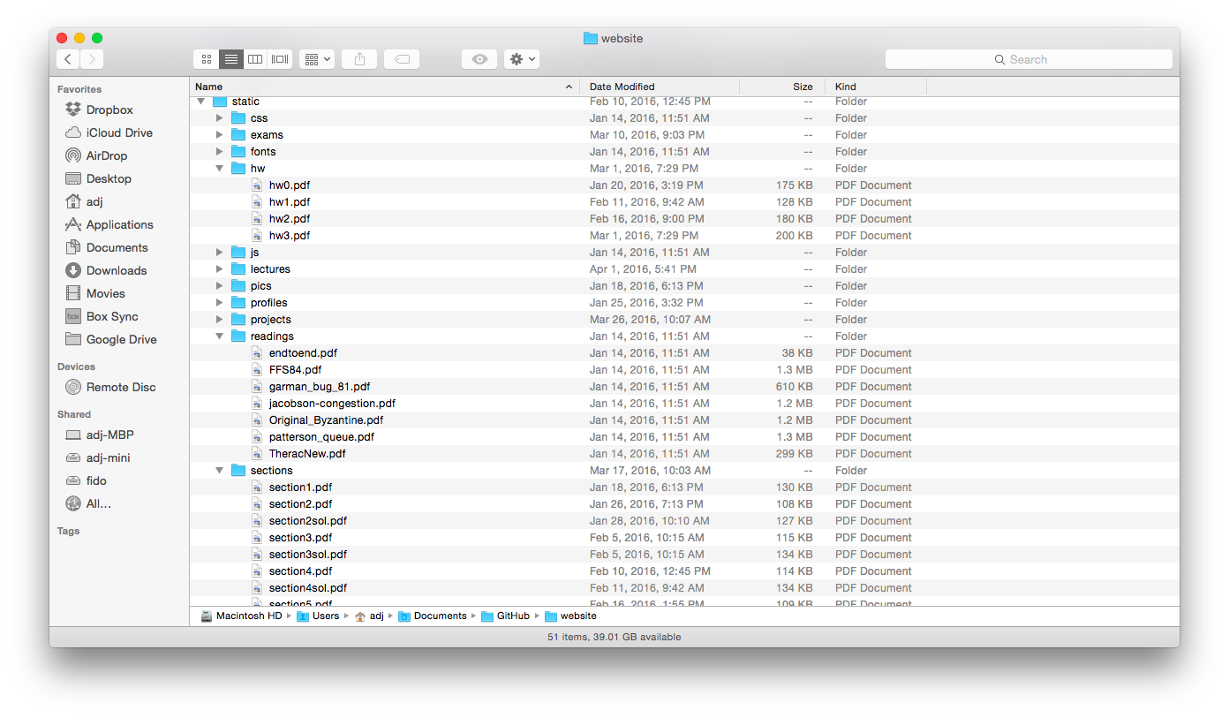
Directories

Slide 15
Directory
Basically a hierarchical structure
Each directory entry is a collection of
Files
Directories
A link to another entries
Each has a name and attributes
Files have data
Links (hard links) make it a DAG, not just a tree
Softlinks (aliases) are another name for an entry

Slide 16
I/O & Storage Layers
Application / Service
streams
High Level I/O
Low Level I/O
handles
#4 - handle
Syscall
registers
File System
descriptors
I/O Driver
Commands and Data Transfers
Data blocks
Disks, Flash, Controllers, DMA
…
Directory Structure

Slide 17
File
Named permanent storage
Contains
Data
Blocks on disk somewhere
Metadata (Attributes)
Owner, size, last opened, …
Access rights
R, W, X
Owner, Group, Other (in Unix systems)
Access control list in Windows system
Data blocks
File handle
…
File descriptor
Fileobject (inode)
Position

Slide 18
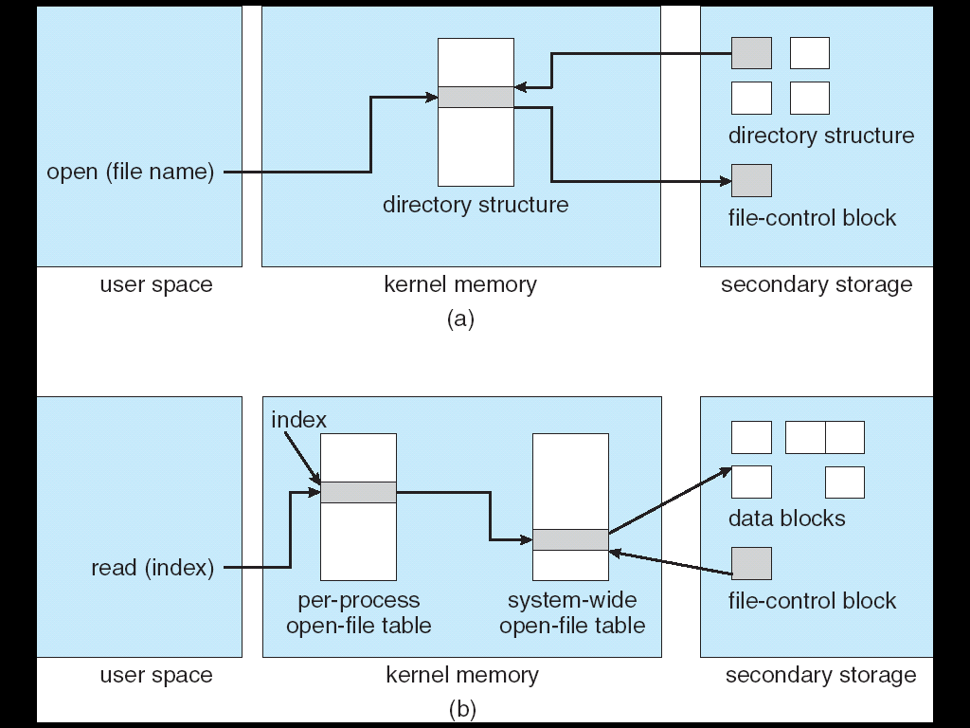
In-Memory File System Structures
Open system call:
Resolves file name, finds file control block (inode)
Makes entries in per-process and system-wide tables
Returns index (called “file handle”) in open-file table

Slide 19
In-Memory File System Structures
Read/write system calls:
Use file handle to locate inode
Perform appropriate reads or writes

Slide 20
Our first filesystem: FAT (File Allocation Table)
The most commonly used filesystem in the world!
Assume (for now) we have a way to translate a path to a “file number”
i.e., a directory structure
Disk Storage is a collection of Blocks
Just hold file data (offset o = < B, x >)
Example: file_read 31, < 2, x >
Index into FAT with file number
Follow linked list to block
Read the block from disk into memory
FAT
Disk Blocks
file number
0:
0:
31:
File 31, Block 0
File 31, Block 1
File 31, Block 2
N-1:
N-1:
memory

Slide 21
FAT Properties
File is collection of disk blocks
FAT is linked list 1-1 with blocks
File Number is index of root of block list for the file
File offset (o = < B, x >)
Follow list to get block #
Unused blocks ⬄ FAT free list
FAT
Disk Blocks
file number
0:
0:
31:
File 31, Block 0
File 31, Block 1
free
File 31, Block 2
N-1:
N-1:
memory

Slide 22
FAT Properties
File is collection of disk blocks
FAT is linked list 1-1 with blocks
File Number is index of root of block list for the file
File offset (o = < B, x > )
Follow list to get block #
Unused blocks ⬄ FAT free list
Ex: file_write(31, < 3, y >)
Grab blocks from free list
Linking them into file
FAT
Disk Blocks
file number
0:
0:
31:
File 31, Block 0
File 31, Block 1
File 31, Block 3
free
File 31, Block 2
N-1:
N-1:
memory

Slide 23
FAT Properties
File is collection of disk blocks
FAT is linked list 1-1 with blocks
File Number is index of root of block list for the file
Grow file by allocating free blocks and linking them in
Ex: Create file, write, write
FAT
Disk Blocks
file number
0:
0:
31:
File 31, Block 0
File 31, Block 1
File 63, Block 1
File 31, Block 3
free
63:
File 63, Block 0
File 2 number
File 31, Block 2
N-1:
N-1:
memory

Slide 24
FAT Assessment
FAT32 (32 instead of 12 bits) used in Windows, USB drives, SD cards, …
Where is FAT stored?
On Disk, on boot cache in memory, second (backup) copy on disk
What happens when you format a disk?
Zero the blocks, link up the FAT free-list
What happens when you quick format a disk?
Link up the FAT free-list
Simple
Can implement in device firmware
FAT
Disk Blocks
file number
0:
0:
31:
File 31, Block 0
File 31, Block 1
File 63, Block 1
File 31, Block 3
free
63:
File 63, Block 0
File 2 number
File 31, Block 2
N-1:
N-1:
memory

Slide 25
FAT Assessment – Issues
Time to find block (large files) ??
Block layout for file ???
Sequential Access ???
Random Access ???
Fragmentation ???
MSDOS defrag tool
Small files ???
Big files ???
FAT
Disk Blocks
file number
0:
0:
31:
File 31, Block 0
File 31, Block 1
File 63, Block 1
File 31, Block 3
free
63:
File 63, Block 0
File 2 number
File 31, Block 2
N-1:
N-1:
memory

Slide 26
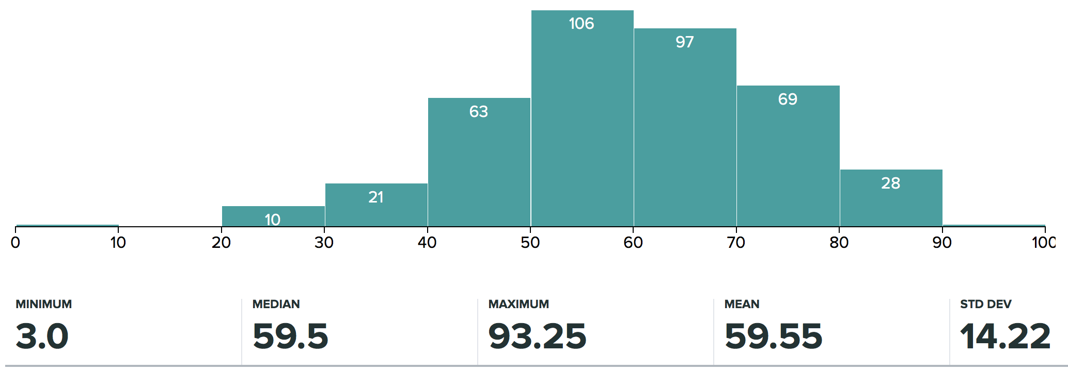
Administrivia
Midterm 2 regrade requests now open (until next Monday, April 9)
Project 2 code due tonight at 11:59PM
Final report due Wed April 4 at 11:59 PM

Slide 27
break

Slide 28
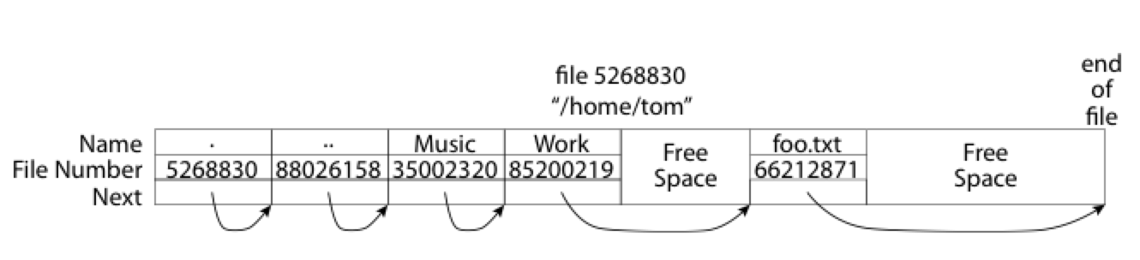
What about the Directory?
Essentially a file containing <file_name: file_number> mappings
Free space for new entries
In FAT: file attributes are kept in directory (!!!)
Each directory a linked list of entries
Where do you find root directory ( “/” )?

Slide 29
Directory Structure (cont’d)
How many disk accesses to resolve “/my/book/count”?
Read in file header for root (fixed spot on disk)
Read in first data block for root
Table of file name/index pairs. Search linearly – ok since directories typically very small
Read in file header for “my”
Read in first data block for “my”; search for “book”
Read in file header for “book”
Read in first data block for “book”; search for “count”
Read in file header for “count”
Current working directory: Per-address-space pointer to a directory (inode) used for resolving file names
Allows user to specify relative filename instead of absolute path (say CWD=“/my/book” can resolve “count”)

Slide 30
Many Huge FAT Security Holes!
FAT has no access rights
FAT has no header in the file blocks
Just gives an index into the FAT
(file number = block number)

Slide 31
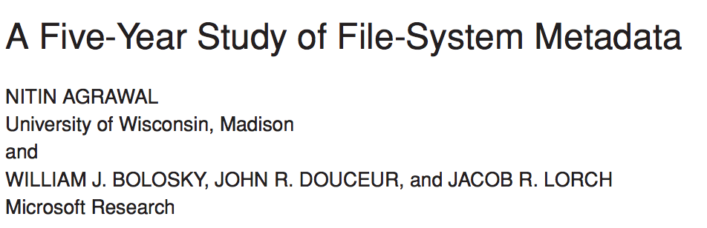
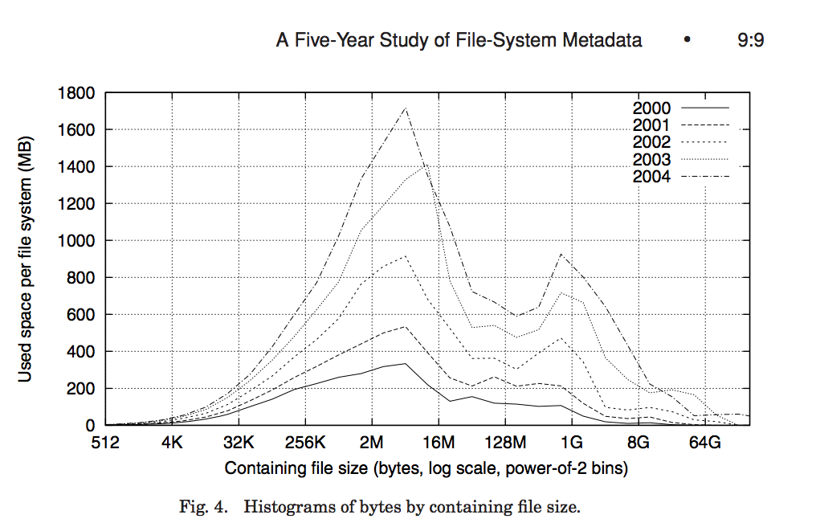
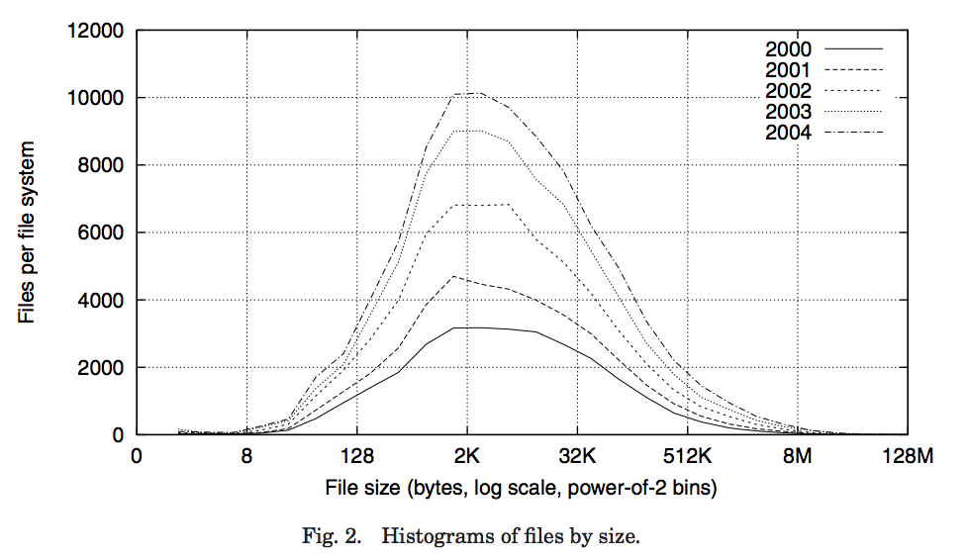
Characteristics of Files
Notes:
FAST’07 paper
Data from >10K PCs at MS
May be skewed by corporate distros

Slide 32
Characteristics of Files
Most files are small, growing numbers of files over time
Notes:
From 30k to 90k files

Slide 33
Characteristics of Files
Most of the space is occupied by the rare big ones
Notes:
15% file size growth/year
New peaks are DB, video, and blob (email) files
Median capacity from 5 to 40GB

Slide 34
So What About a “Real” File System?
Meet the inode:
file_number

Slide 35
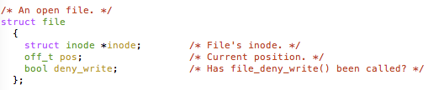
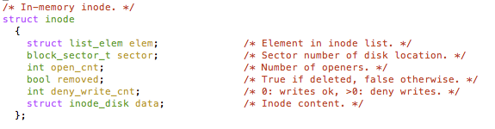
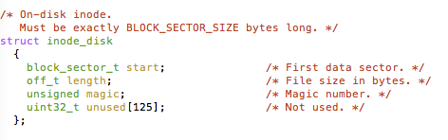
An “Almost Real” File System
Pintos: src/filesys/file.c, inode.c
file_number

Slide 36
Unix File System
Original inode format appeared in BSD 4.1
Berkeley Standard Distribution Unix
Part of your heritage!
Similar structure for Linux Ext2/3
File Number is index into inode arrays
Multi-level index structure
Great for little and large files
Asymmetric tree with fixed sized blocks
Metadata associated with the file
Rather than in the directory that points to it
UNIX Fast File System (FFS) BSD 4.2 Locality Heuristics:
Block group placement
Reserve space
Scalable directory structure

Slide 37
File Attributes
inode metadata
User
Group
9 basic access control bits
- UGO x RWX
Setuid bit
- execute at owner permissions rather than user
Setgid bit
- execute at group’s permissions

Slide 38
Data Storage
Small files: 12 pointers direct to data blocks
Direct pointers
4kB blocks ⇒ sufficient for files up to 48KB

Slide 39
Data Storage
Large files: 1,2,3 level indirect pointers
Indirect pointers
- point to a disk block
containing only pointers
- 4 kB blocks => 1024 ptrs
=> 4 MB @ level 2
=> 4 GB @ level 3
=> 4 TB @ level 4
48 KB
+4 MB
+4 GB
+4 TB

Slide 40
Summary
File System:
Transforms blocks into Files and Directories
Optimize for access and usage patterns
Maximize sequential access, allow efficient random access
File (and directory) defined by header, called “inode”
File Allocation Table (FAT) Scheme
Linked-list approach
Very widely used: Cameras, USB drives, SD cards
Simple to implement, but poor performance and no security
Look at actual file access patterns – many small files, but large files take up all the space!

